Slide 1
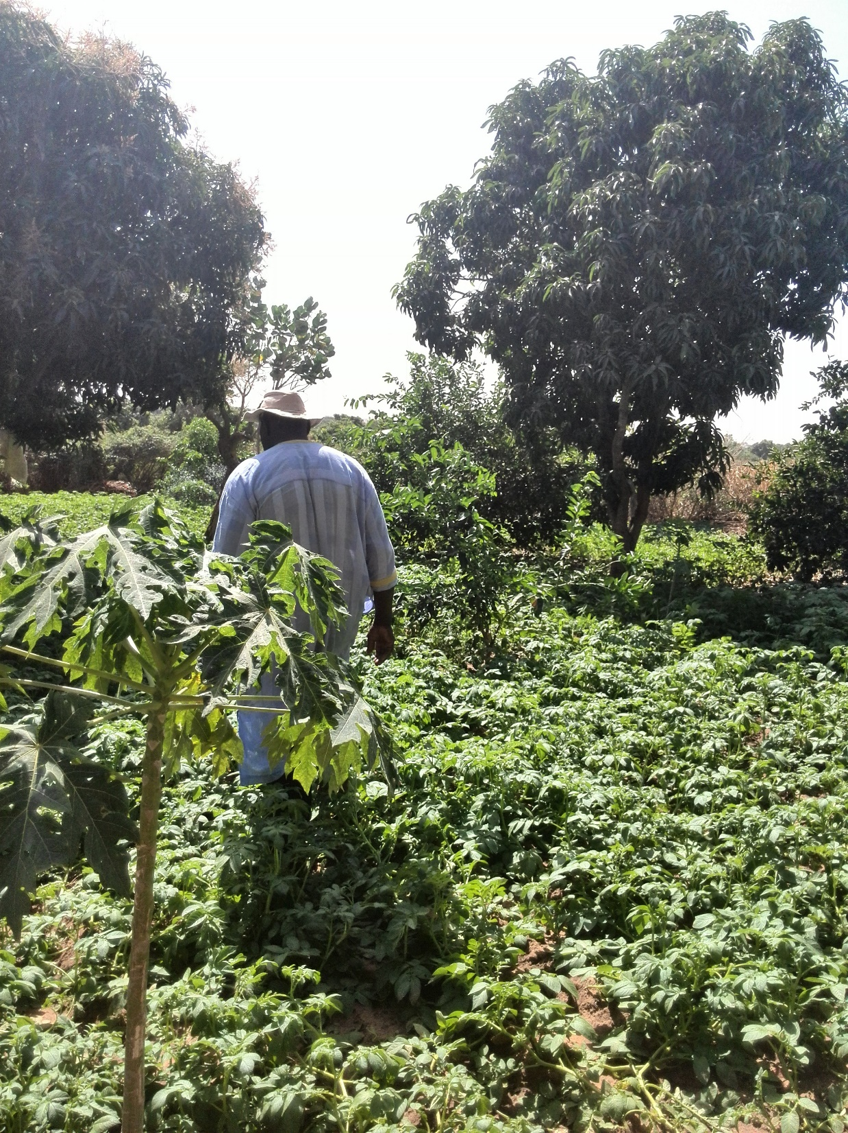
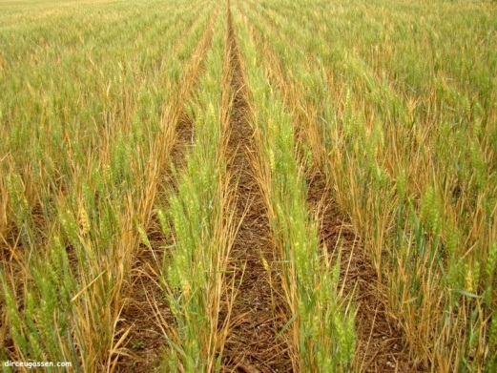

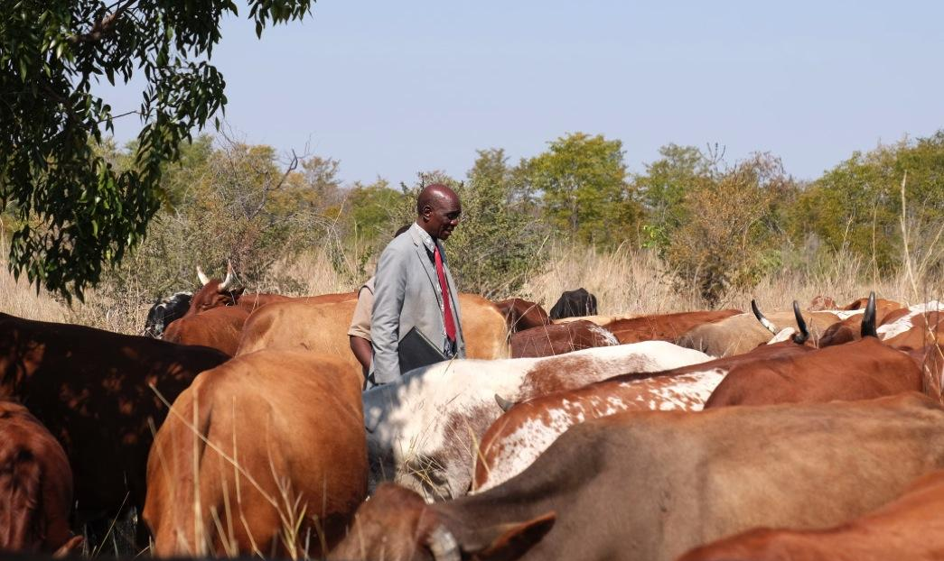




A New Trans-Disciplinary Approach to Regional Integrated
Assessment of Climate Impact and Adaptation in Agricultural Systems
Ibrahima Hathie
Initiative Prospective Agricole et Rurale (IPAR)
&
AgMIP CIWARA CO-PI
Dakar - June 1, 2016
Notes:
‹#›

Slide 2
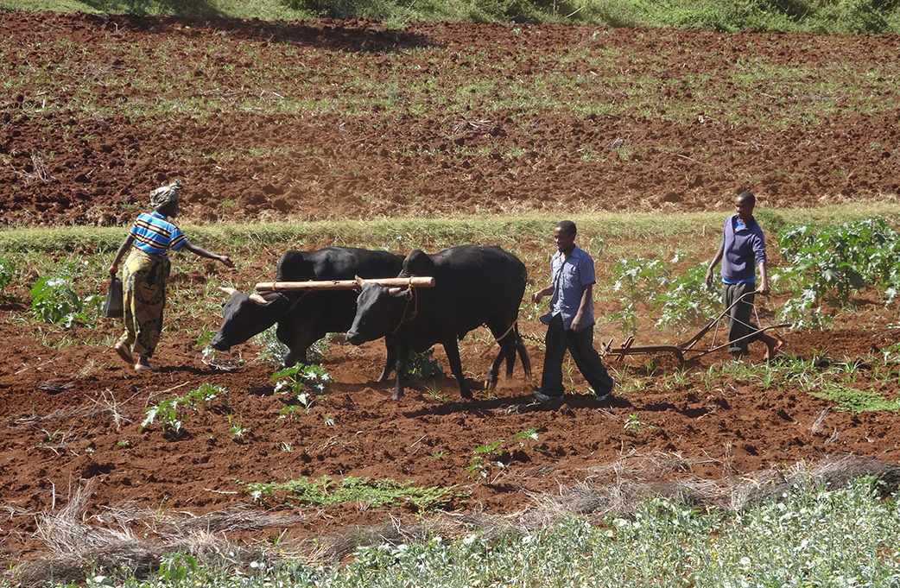
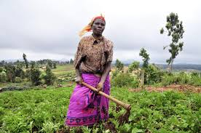
AgMIP Mission
Provide effective science-based agricultural
decision-making models and assessments of climate
variability and change and sustainable farming systems to
achieve local-to-global food security
Near Arusha, Tanzania
‹#›
Notes:
‹#›

Slide 3
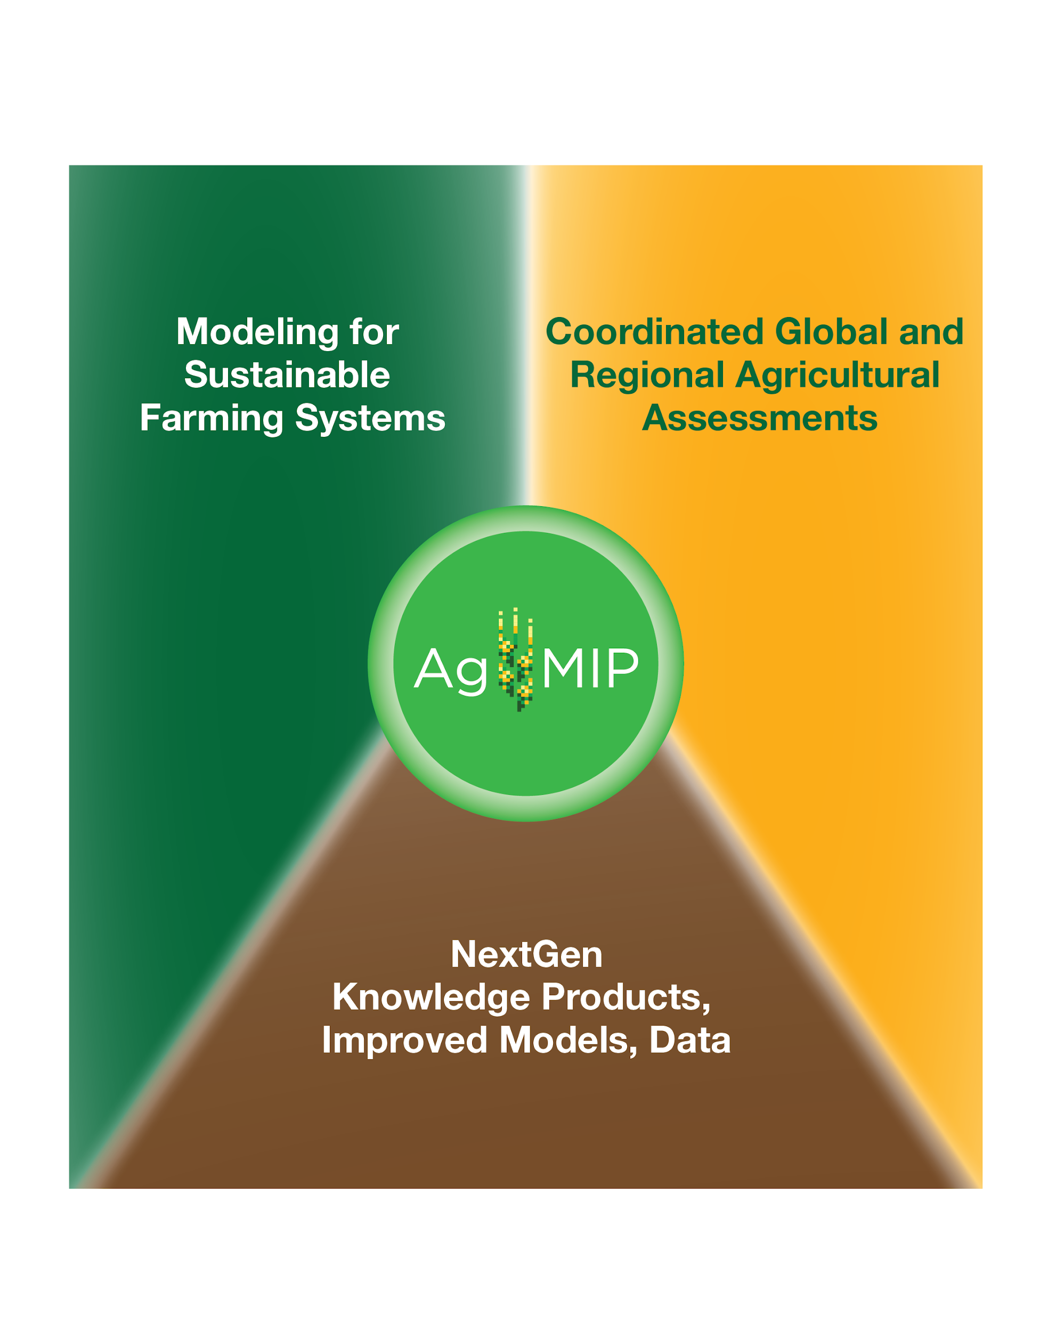
AgMIP Objectives
Incorporate state-of-the-art climate products as well as crop and agricultural trade model improvements in coordinated regional and global assessments of future climate impacts
Include multiple models, scenarios, locations, crops and participants to explore uncertainty and impact of data and methodological choices
Collaborate with regional experts in agronomy, economics, and climate to build strong basis for applied simulations addressing key climate-related questions
Improve scientific and adaptive capacity for major agricultural regions in the developing and developed world
Develop framework to identify and prioritize adaptation strategies
3 Focus areas
‹#›
Notes:
‹#›

Slide 4
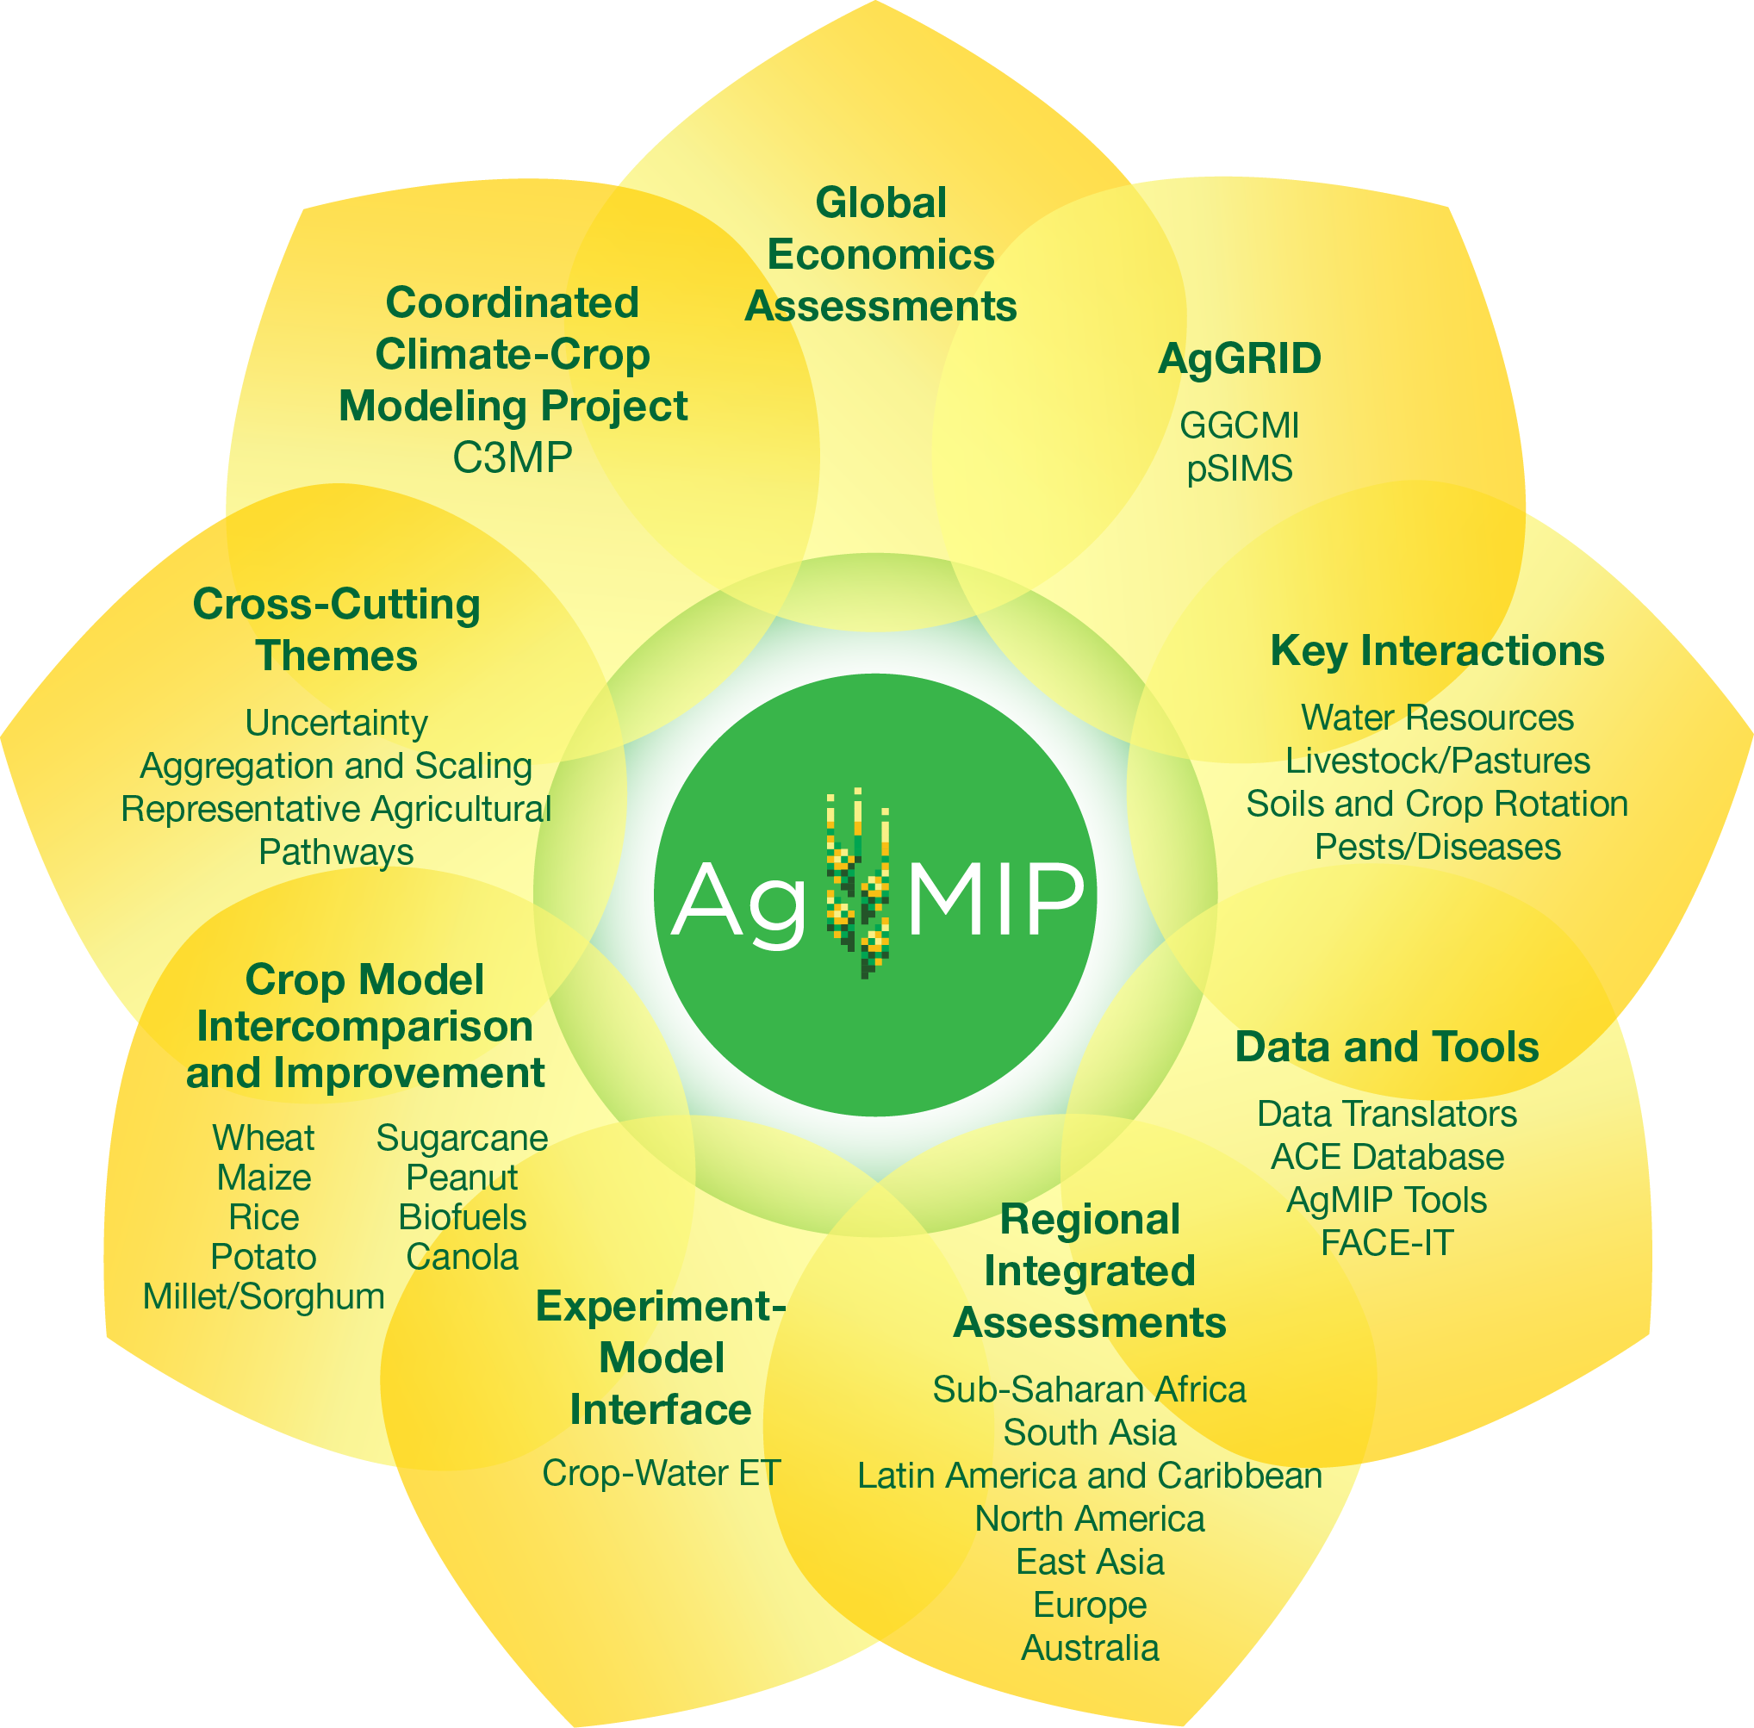
Current Activities
‹#›
Notes:
‹#›

Slide 5
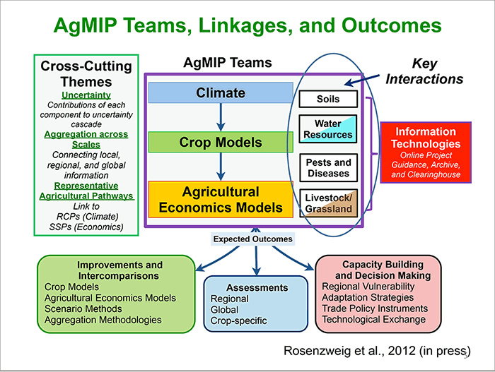
‹#›
Antle et al., 2015
Notes:
‹#›

Slide 6
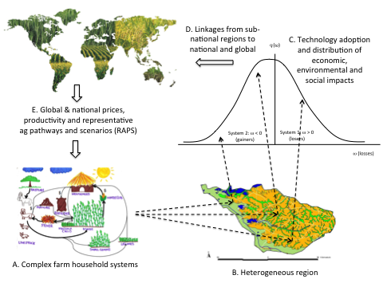
AgMIP Regional Integrated Assessment – 5 Attributes
Farming systems
Transdisciplinary:
climate/biophysical/
socio-economic
Multi-scale: field, farm, region, global data and models
Multiple climate and crop models
Distributional results: impacts on poverty
‹#›
Antle et al., 2015
Notes:
‹#›

Slide 7
Key features of AgMIP’s RIA approach
A protocol-based approach: rigorously documented so results can be replicated and inter-compared, and methods improved
Participatory: identification of impact indicators, choice of key systems, adaptations, design of future pathways and scenarios used
A trans-disciplinary, systems-based approach: must include key features of current and possible future systems, including multiple crops, inter-crops, livestock, and non-agricultural sources of income.
Heterogeneity: must account for the diversity of systems, and the widely varying bio-physical and socio-economic conditions
Vulnerability: must be possible to characterize the impacts on those farm households that are adversely impacted by climate change, as well as those that benefit from climate change.
Key uncertainties in climate, production system and economic dimensions of the analysis must be assessed and reported so that decision makers can understand them and use them to interpret the results of the analysis.

Slide 8
AgMIP’s Trans-disciplinary IA Approach
Climate data
RCPs
SSPs
Crop, Livestock Models
Regional RAPs
Global RAPs
Experiments, Surveys
& Expert data
Relative yield distributions
Global & Regional Econ Models
Economic Impact Model
(TOA-MD)
Prices and Costs
Economic, Environmental, Social Impacts

Slide 9
Core Questions for Regional Integrated Assessment
Q1. What is the sensitivity of current agricultural production systems to climate change?
Q2. What are the benefits of adaptation in current agricultural systems?
Q3. What is the impact of climate change on future agricultural production systems?
Q4. What are the benefits of climate change adaptations?
‹#›
Notes:
‹#›

Slide 10
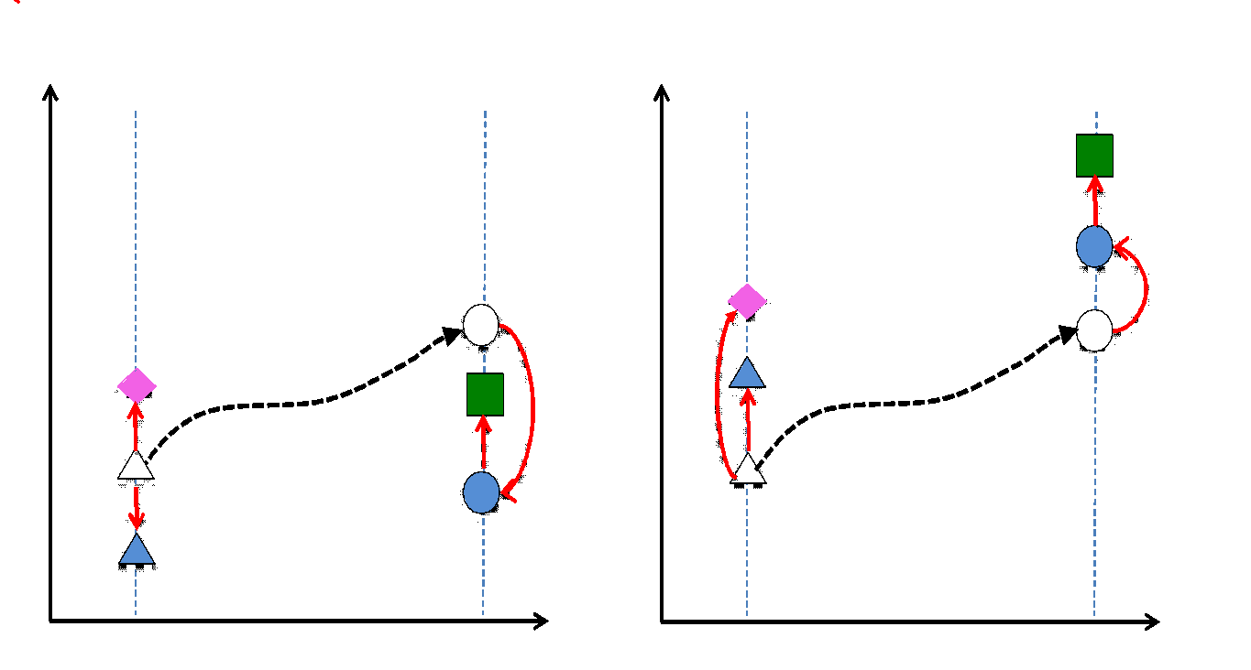
Core Questions for Regional Integrated Assessment
Core climate impact questions and the states of the production system that will be simulated with negative impacts of climate change (left) and positive impacts of climate change (right)
‹#›
Notes:
‹#›

Slide 11
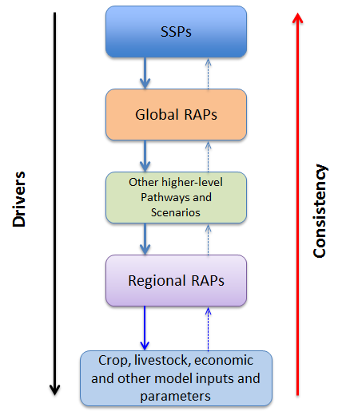
Linking Agriculture-Specific Pathways to SSPs:
Representative Agricultural Pathways (RAPs)
-> Hierarchical structure (nested approach)
. SSPs: Framework for development of sectoral (e.g. agricultural) global and regional scenarios.
Global RAPs: Global Economic Models and other non-modeled global socio-economic conditions:
  GDP, population & policy and trade, etc
Regional RAPs: Allow us to include key drivers likely to affect future bio-physical and socio-economic conditions:
  ag productivity trends, land use, policy, regional development
  farm size, system-specific productivity & management, infrastructure, etc
  AgMIP:
  Developing and implementing Representative Agricultural Pathways and Scenarios (RAPS)
Notes:
Hierarchical structure
-Mention that we talk about global RAPs and regional RAPs but could be intermediate level pathways, like the multi-country scenarios developed by CCAFS in SSA and SA
‹#›

Slide 12
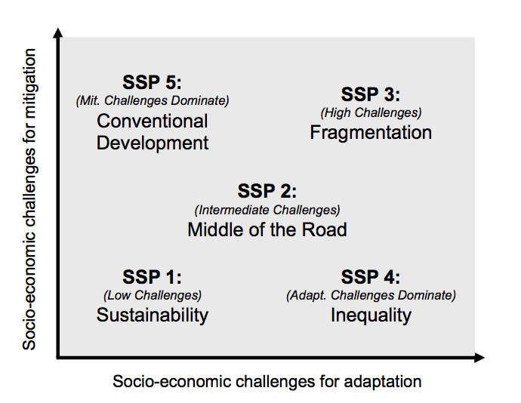
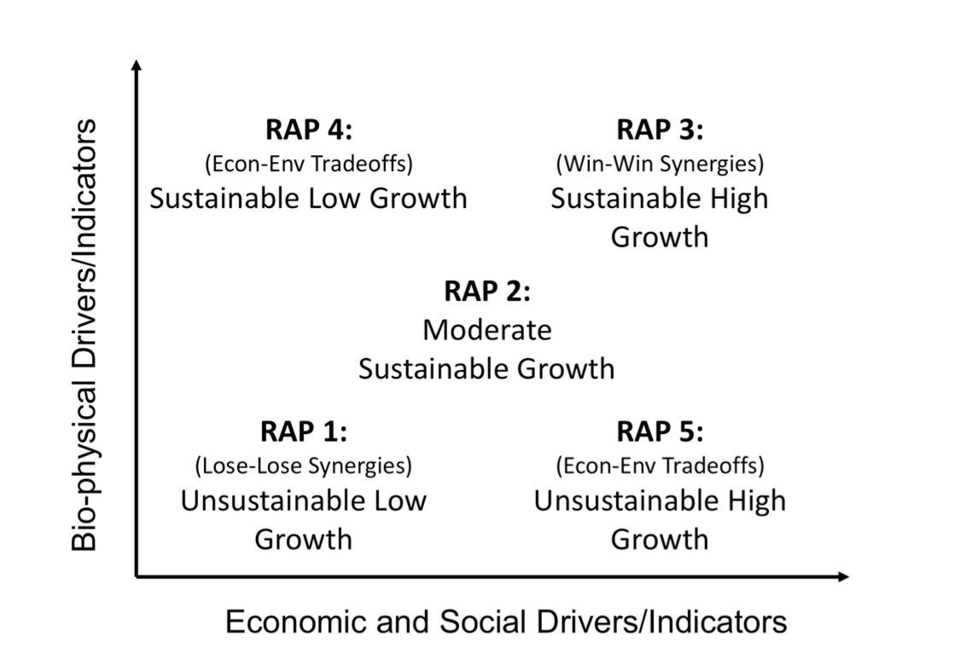
Future socio-economic scenarios: Linking SSPs, RCPs, RAPs and price/productivity trends
RAP 4: “Sustainable low growth (SLG)”. This RAP will be combined with RCP 4.5 and with global economic model outputs associated with SSP1.
RAP 5: “Unsustainable high growth (UHG)”. This RAP will be combined with RCP 8.5 and with global economic model outputs associated with SSP3 (or SSP5 if available).
RCP 4.5
RCP 8.5

Slide 13
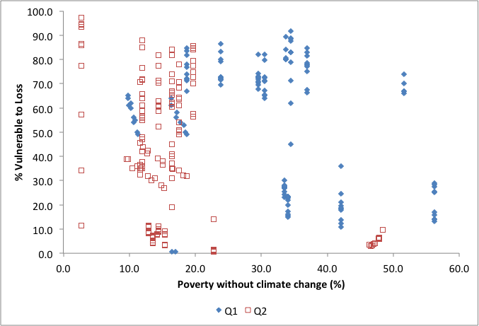
AgMIP Regional RIAs: Importance of Future Scenarios (RAPS)
Each point = RCP 8.5 climate x crop model x region

Slide 14
Adaptation Packages: Key Features
Adaptation packages in core question 2 are changes in the production system under the current climate (no climate change)
Adaptation packages in core question 4 are changes in the future production system in response to climate change
Adaptation elements:
Within-System adaptations
  Crop varieties, fertilizer use, plant density, etc.
  Breeds, feeding strategy, etc
  Land allocation among activities
Between-system adaptations:
  Change crops or livestock
Economic Adaptations:
  Could be both with- and between-system adaptations, motivated by economic considerations (e.g. changes in prices).
    Land allocation within system
    Off farm labor
‹#›
Notes:
‹#›

Slide 15
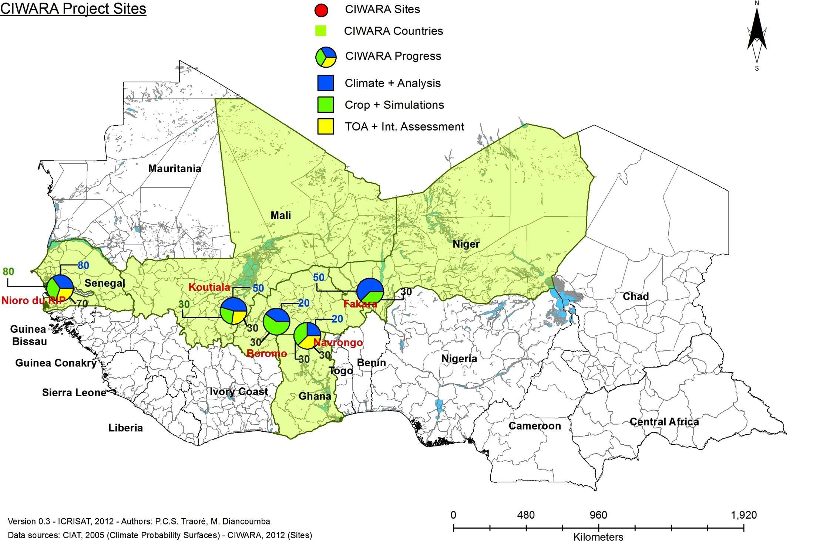
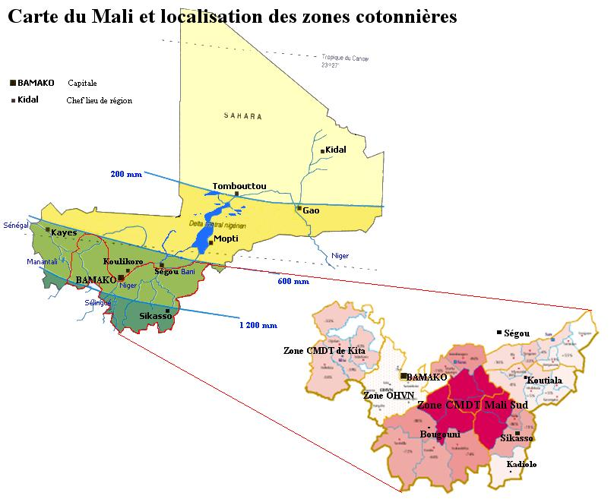
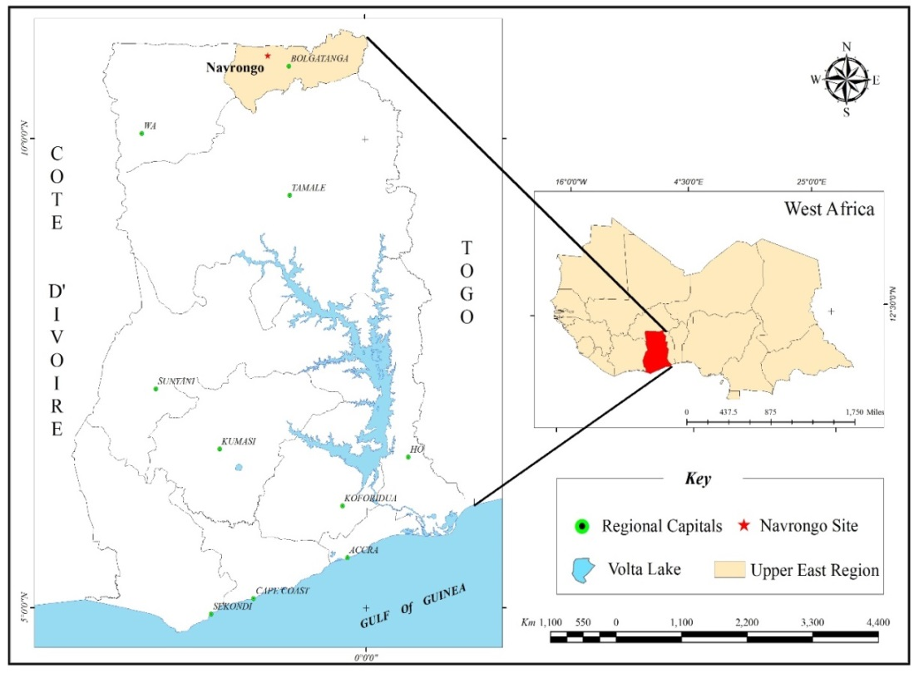
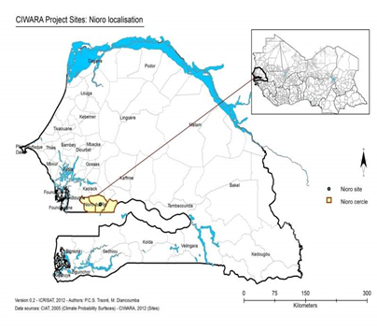
CIWARA SITES – PHASE II
‹#›

Slide 16
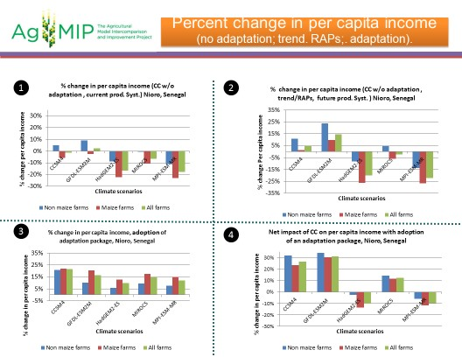
*
‹#›

Slide 17

THANK YOU
‹#›

